Slide 1
Smart Stock Inventory Optimization For Retail Stores

Slide 2
Introduction
Smart Stock is an ML-based system that predicts future product demand in retail stores by analyzing historical sales data and trends. It helps reduce stockouts and overstock by suggesting accurate stock levels, improving both customer satisfaction and inventory costs. The system uses the Random Forest algorithm for reliable and accurate demand forecasting. The backend is built using Flask for API handling, while the frontend uses HTML/CSS for a simple user interface. The model is trained on a Kaggle dataset containing historical retail sales.

Slide 3
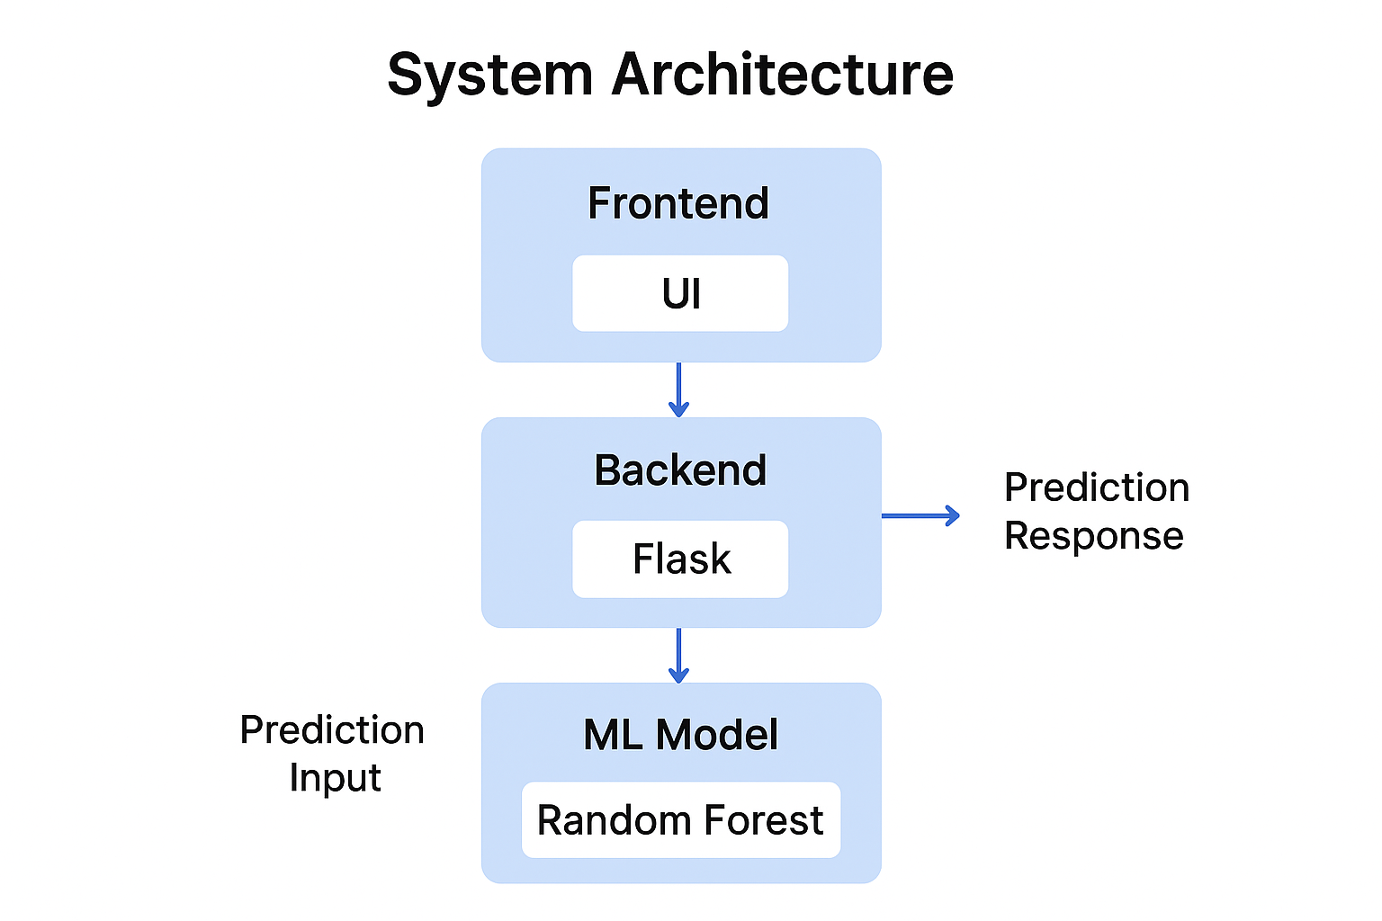

Slide 4
Tech Stack Used
Frontend
HTML5 – Basic structure of the user interface
CSS3 – Styling, layout, and clean UI design
JavaScript – API calls to Flask backend and dynamic output display
Backend
Flask (Python) – Handles APIs for prediction and model training
REST API – For sending and receiving JSON data between UI and backend
Machine Learning
Python (NumPy, Pandas) – Data preprocessing and feature engineering
Scikit-learn – Random Forest training, evaluation, and prediction
Joblib – Saving and loading the trained ML model (smartstock_model.pkl)

Slide 5
Machine Learning Algorithm
Random Forest Regressor is the main ML model used for predicting product demand.
It builds multiple decision trees and combines their results for higher accuracy.
Handles noisy and seasonal retail sales data better than a single model.
Learns patterns based on store ID, item ID, date (day, month, year), and past sales.
Manages missing values and outliers effectively without major preprocessing.
Produces stable predictions even with large datasets.
Achieved low RMSE, showing good prediction performance.
Final trained model is saved as smartstock_model.pkl and used by Flask for real-time forecasting.

Slide 6
Dataset Details
Dataset from Kaggle (Store Item Demand Forecasting).
Contains one CSV file with date, store, item, sales.
Time-series structured data.
Used for demand prediction and trend analysis.
Work Completed
Collected problem statement & requirements.
Downloaded Kaggle dataset (single CSV).
Performed data cleaning & preprocessing.
Completed Exploratory Data Analysis (EDA).
Trained baseline Random Forest model.

Slide 7
Key Modules in the Project
Data Preprocessing Module – Cleans and transforms raw data.
ML Training Module – Trains Random Forest on historical sales.
Prediction Module – Generates demand prediction from input.
API Layer (Flask) – Communicates between UI and model.
User Interface Module – Takes input and displays results.

Slide 8
Future Enhancements
Integrate with MySQL for storing demand history.
Add product-level alerts for reordering.
Deploy on Render
Add mobile-friendly version.

Slide 9
Thank You!!

